Slide 1
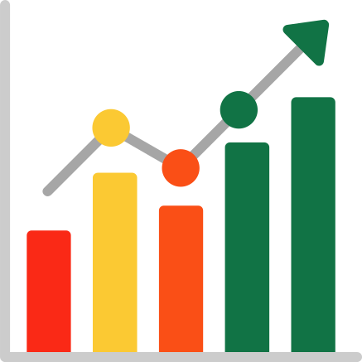


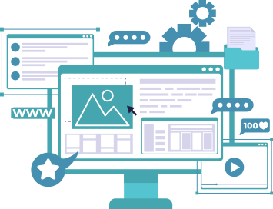
EDS Project on:
Exploring the Titanic data
Presented By:
Guided By: S.P Kale (MITAOE)
230 : Aditya Babar (202201070130)
231 : Janhavi Kawadkar (202201060008)
236 : Rohan Agrawal (202201040208)
FYBTech,MITAOE

Slide 2
Introduction
Data analytics is the process of examining vast volumes of data to extract meaningful patterns, trends, and correlations.
In the context of the Titanic dataset, data analysis becomes a window through which we can do various analysis such as data manipulation, data visualization ,etc.
By applying robust data analysis techniques, we aim to uncover the factors that influenced survival rates, understand the demographics of the passengers, and reveal intriguing correlations within the dataset.

Slide 3
Motivation
The sinking of the Titanic is a well-known historical event, and the dataset provides information about the passengers on board, including their demographics, ticket class, cabin, fare, survival status, etc. Analyzing this dataset allows us to gain insights into various factors that might have influenced the survival of passengers during the tragedy.

Slide 4
Details of Dataset
Name: Titanic dataset
Number of features: 14
Number of records: 891

Slide 5
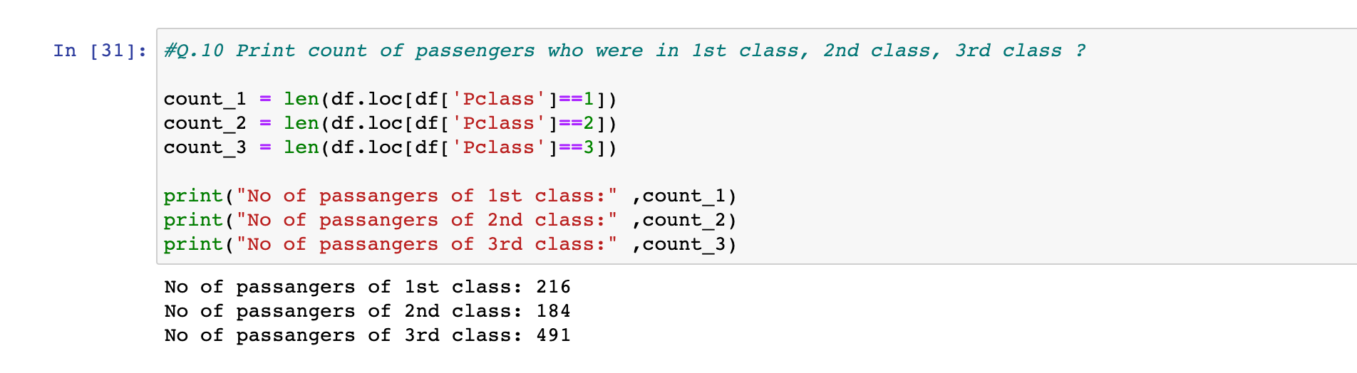
Data Manipulation
Data manipulation is a fundamental process in data analysis that involves transforming and preparing raw data to make it suitable for further exploration and analysis. It encompasses a range of operations aimed at ensuring data quality, consistency, and usability. Missing values can be imputed or removed, while outliers can be addressed through various methods such as transformation.

Slide 6
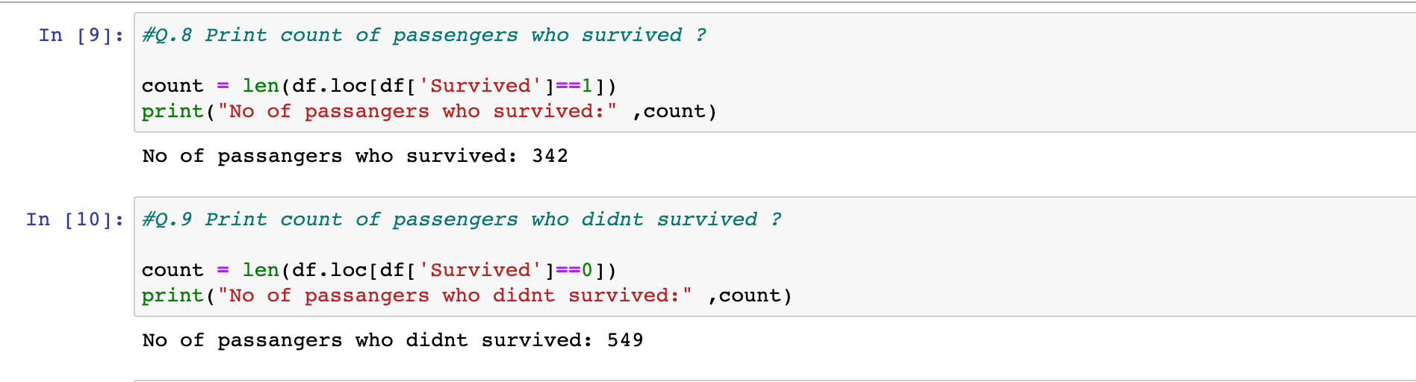
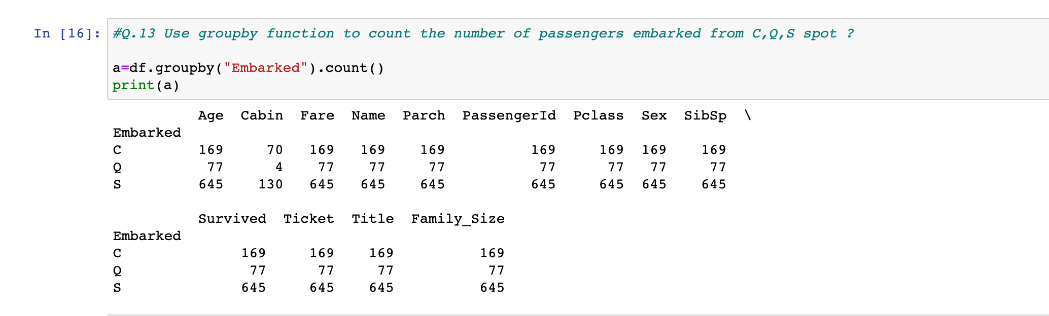

Slide 7
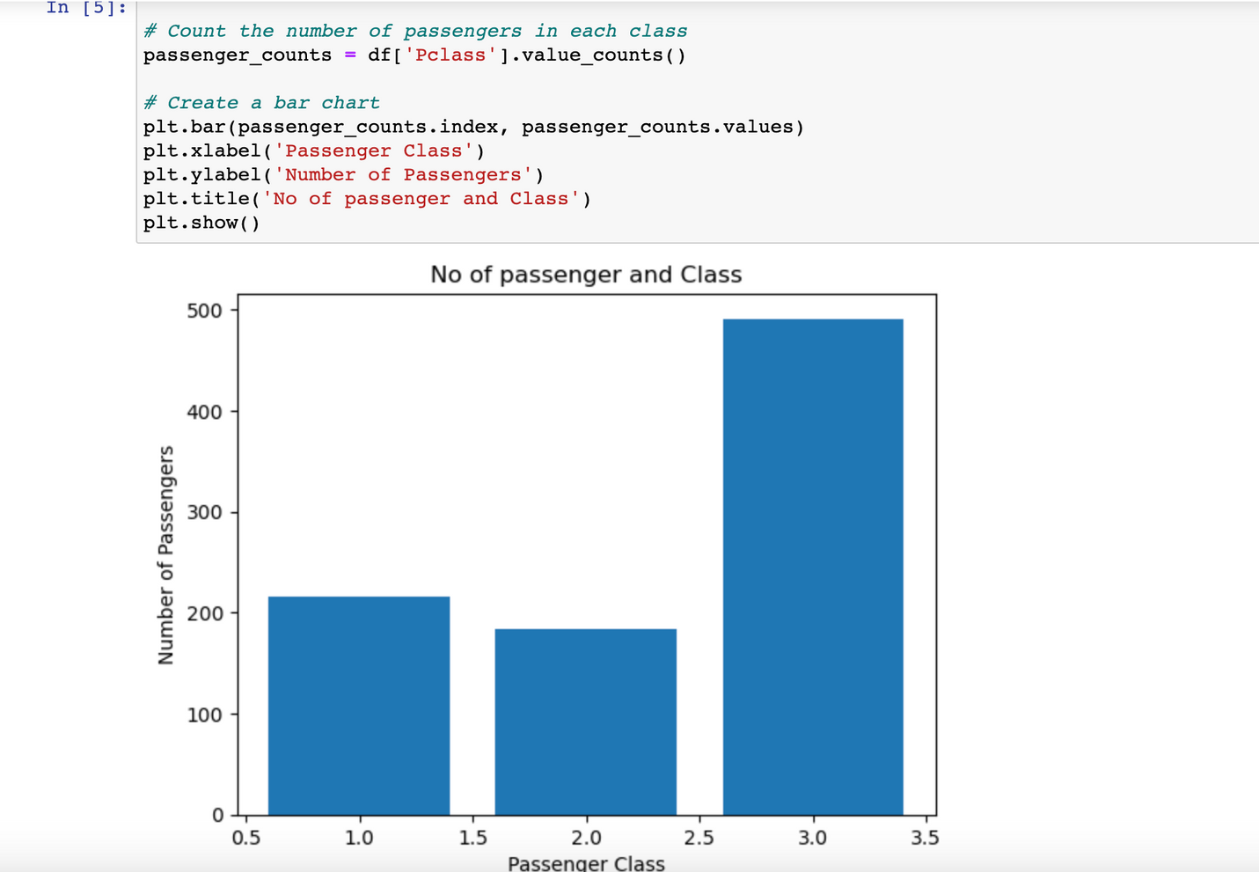
Data Visualization
Data visualization is the process of representing data and information visually through charts, graphs, maps, and other graphical elements. It is a powerful technique that allows us to effectively communicate complex concepts, patterns, and trends in a visual format. Data visualization transforms complex data into visual representations that enhance understanding, reveal patterns, and support decision-making.

Slide 8
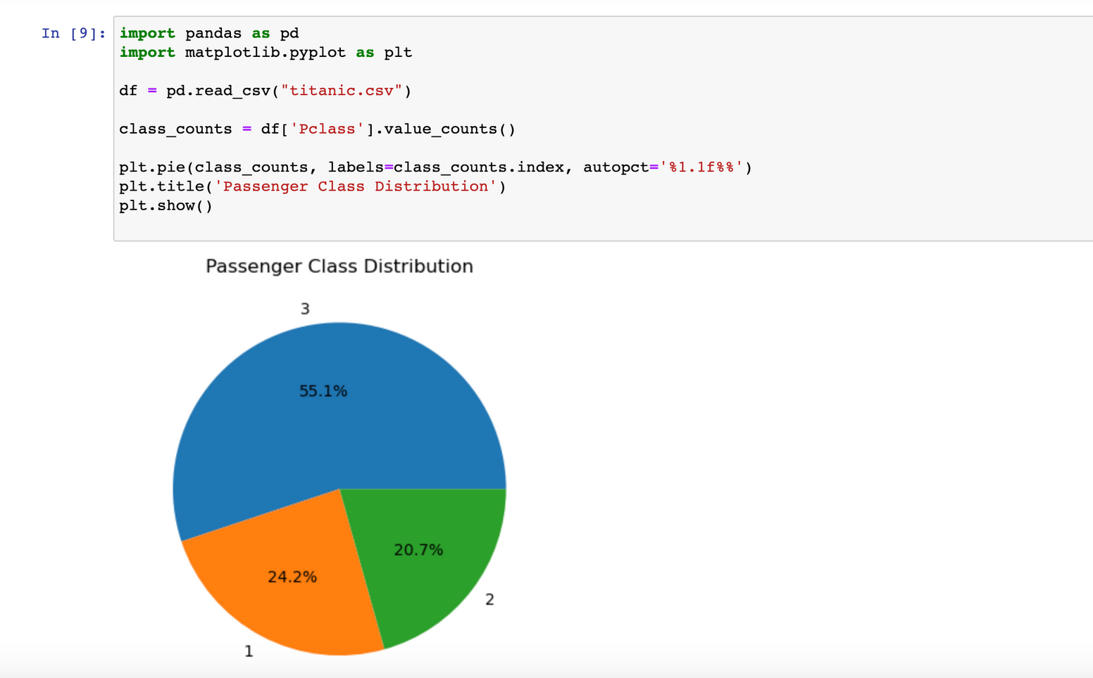
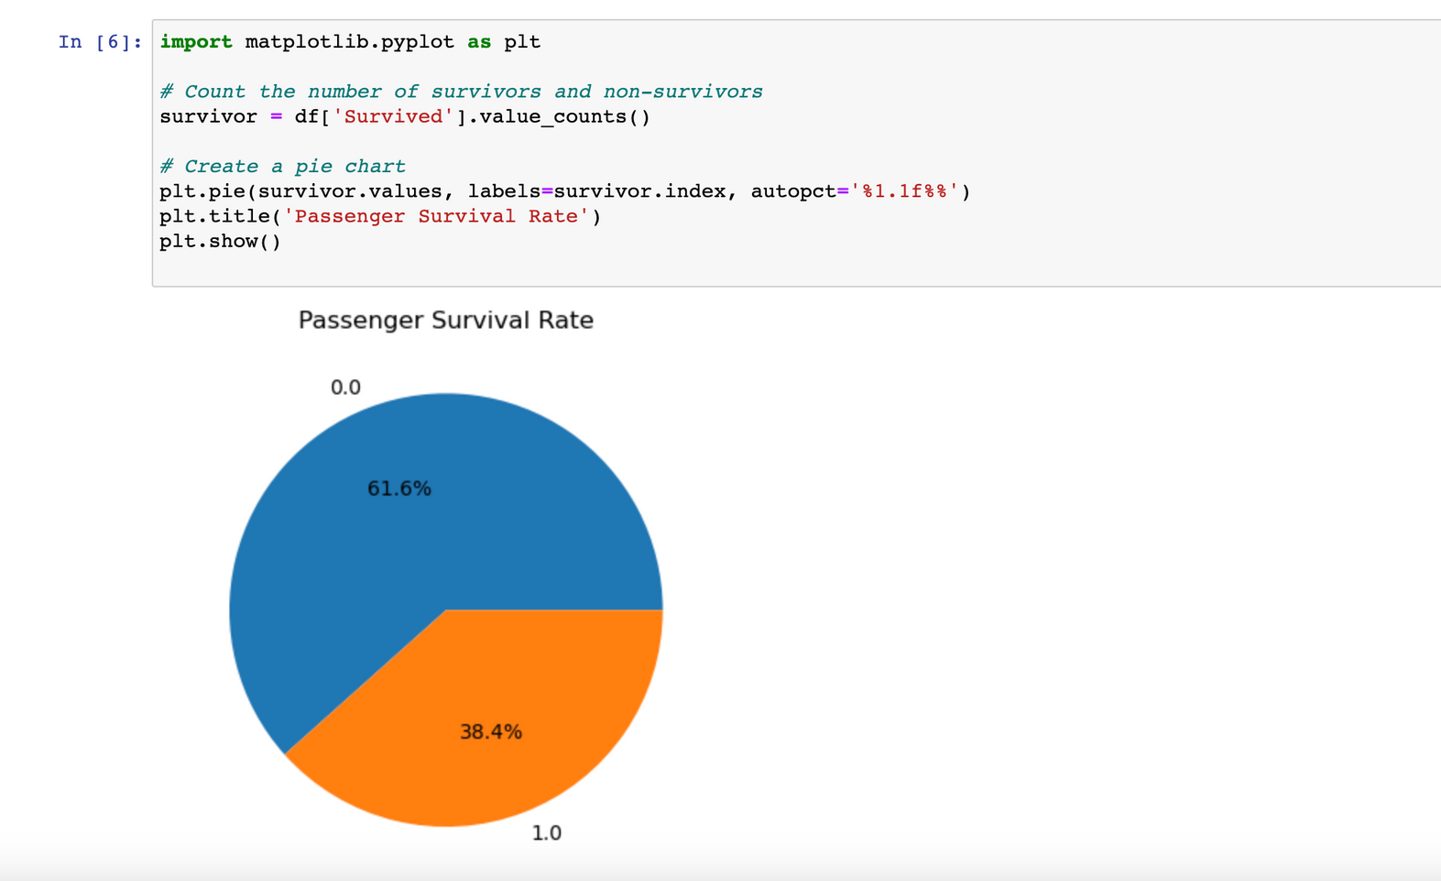

Slide 9
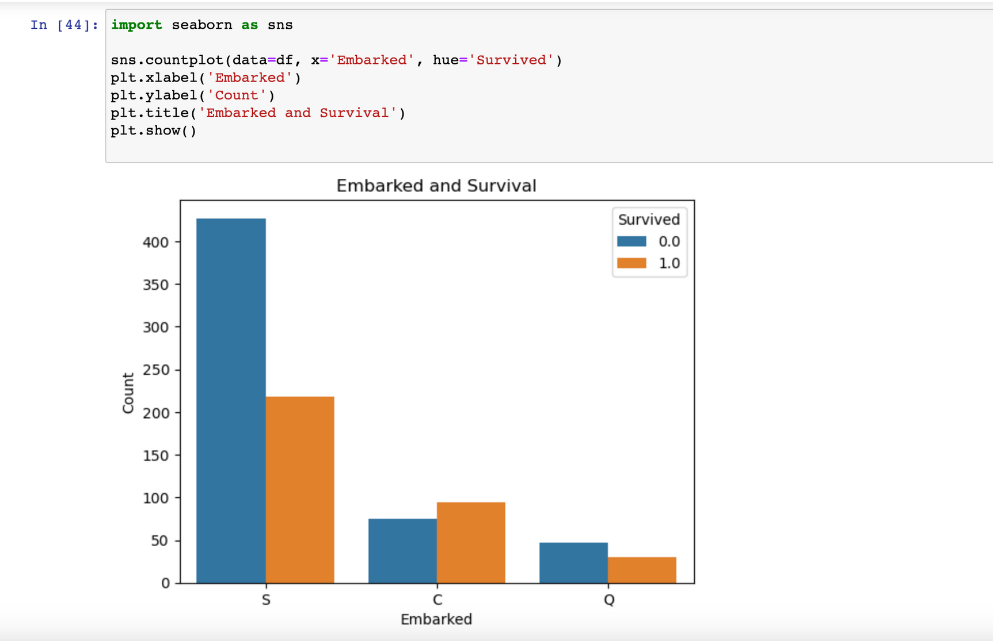
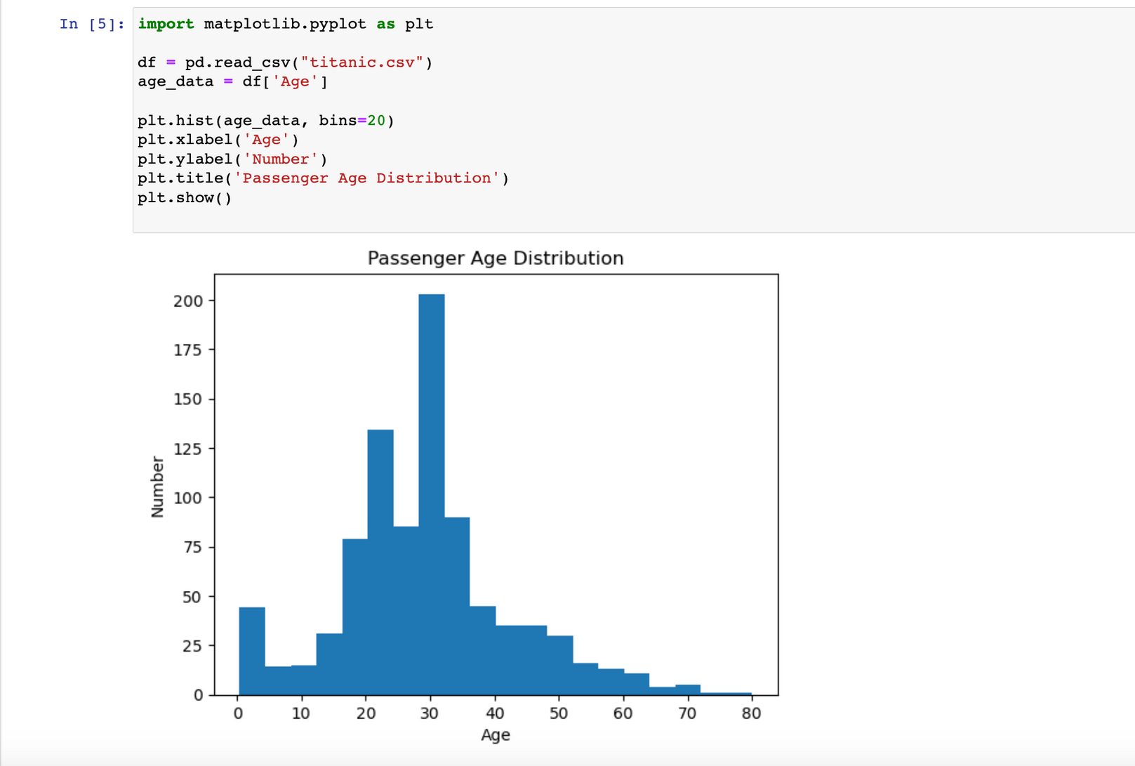

Slide 10
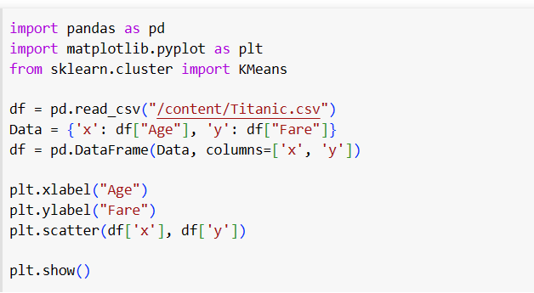
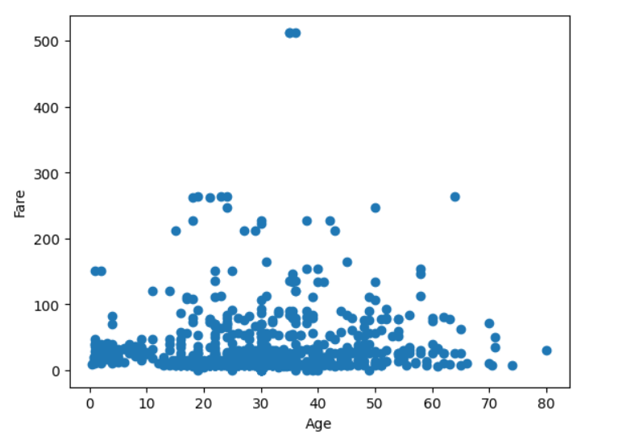
Predictive Technique (K Means)

Slide 11
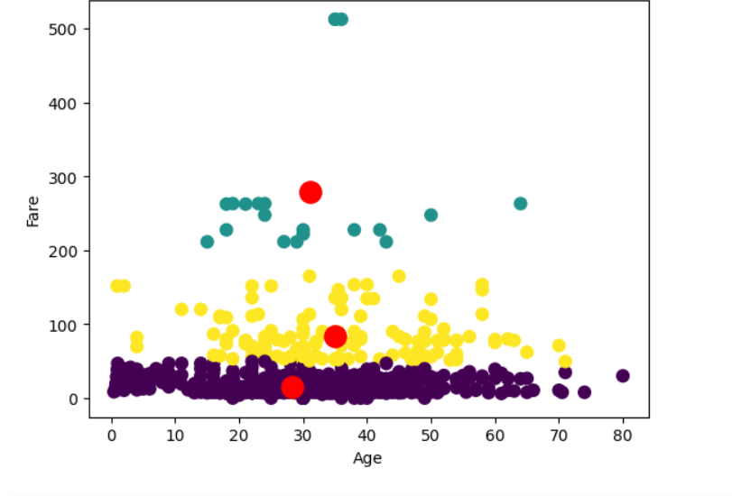
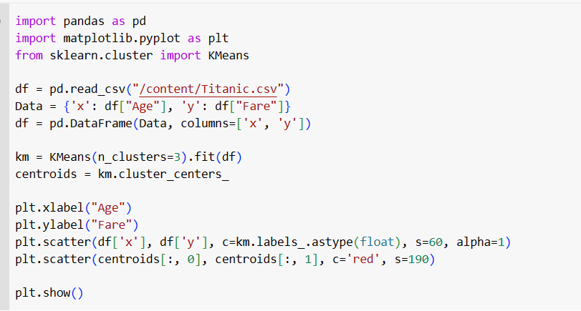

Slide 12
Application
By performing data manipulation techniques such as cleaning, filtering, and transforming the dataset, you can gain a deeper understanding of the data. Exploring summary statistics, distributions, and correlations between variables can provide insights into the characteristics and relationships within the dataset.
Visualizing the Titanic dataset can help uncover patterns, trends, and relationships between variables. Plots such as histograms, scatter plots and bar charts can provide visual representations.
After performing data manipulation, visualizing the data, and clustering using K-means, the resulting clusters can serve as new features for predictive modeling. The cluster labels can be used as input features to build a classification model to predict survival or any other relevant outcome.

Slide 13
Conclusion
In conclusion, our analysis of the Titanic dataset has provided valuable insights into the passengers and the factors influencing their survival.
We discovered significant correlations between survival and variables such as age, gender, passenger class, and family size.
The analysis highlighted the importance of preparedness, class disparities, and gender biases during this tragic event.
Through data cleaning, preprocessing, visualization, and modeling, we were able to extract meaningful information.

